Slide 1




2021- 2024 Strategic Plan Presentation
Presented by:
Strategic Planning Committee

Slide 2
Background Information:
Nearly 30 stakeholders collectively developed a new strategic plan for the district
The plan encompasses:
  A new mission, vision & core beliefs
  Priorities and strategies &
  Performance trends and targets
There is widespread buy-in and/or agreement for the plan amongst all participants
Collectively we present this plan to the Board of Education for approval this evening

Slide 3
Strategic Plan
Mission:
We educate, inspire, and empower all students.
Core beliefs
Students come first.
Everyone can learn and grow.
We ensure equity and create access and opportunity for all.
Diversity is embraced and celebrated.
We provide a safe environment that supports and engages learners.
Everyone is treated with respect and dignity.
We value honesty, integrity, and perseverance.
Data and evidence inform our decisions.
We promote creativity and innovation.
Community, collaboration, and partnerships are vital to our success.
Vision:
An innovative, high performing district that graduates every student.
6.9.2021

Slide 4




2021-24 Priorities & Strategies^{1, 2}
Engage |  | Deliver exceptional learning experiences Ensure rigorous, aligned and relevant curriculum and instruction. Increase literacy rates of all students. Integrate and immerse technology into daily learning. Lower dropout and raise graduation rates, including the percentage of graduates achieving rigorous outcomes. Ensure equitable access to and increase participation in a broad array of enrichment, career and college readiness, and extra-curricular programs.
Support |  | Address students’ diverse social, emotional and academic needs Expand and provide supportive structures that improve the achievement of all students. Foster students’ social and emotional development. Utilize protocols and supports that improve the attendance of our chronically absent students. Implement trauma-informed and restorative practices with fidelity.
Partner |  | Develop strong relationships Nurture and grow parent involvement and community partnerships.
Build |  | Optimize the efficient use of district resources Develop and maintain long-range plans that address budget, operations, facilities, personnel and programs.
¹The district will direct its professional development resources to support the strategies above. ²Priorities are in bold.
6.9.2021

Slide 5
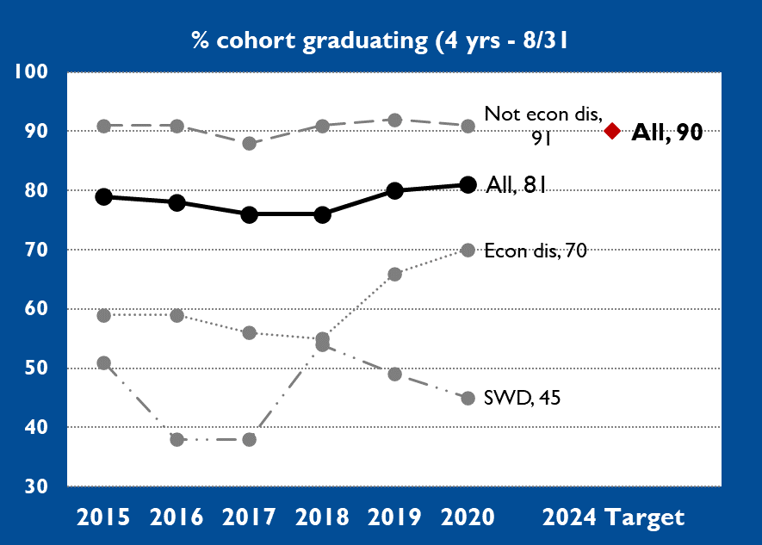
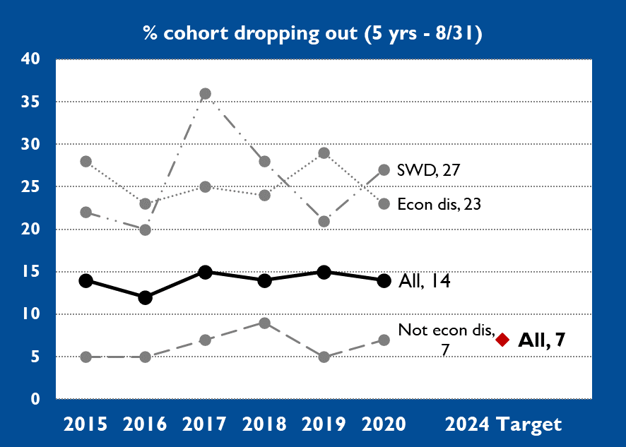
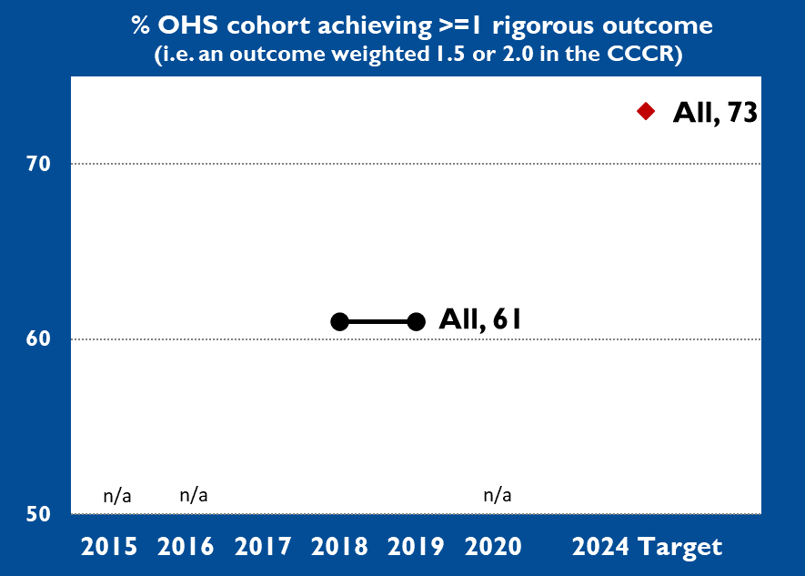
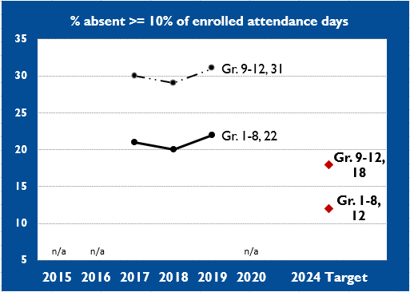
  2015-20 Performance Trends &
  2024 Targets
6.9.2021

Slide 6
  2015-20 Performance Trends &
  2024 Targets
K-3 DIBELS Year-end 2020-21, we will establish a baseline and set an improvement target for “K-3: % achieving year-end grade-level benchmark (DIBELS)” | Gr. 4-8 Oral Reading Fluency Year-end 2020-21, we will establish a baseline and set an improvement target for “Gr. 4-8: % achieving year-end grade-level benchmark (ORF)”
K-8 STAR ELA Year-end 2020-21, we will establish a baseline and set an improvement target for K-1: % achieving year-end grade-level benchmark (STAR) Gr. 2-6: % achieving year-end grade-level benchmark (STAR) Gr. 7-8: % achieving year-end grade-level benchmark (STAR) | K-8 STAR Math Year-end 2020-21, we will establish a baseline and set an improvement target for K-1: % achieving year-end grade-level benchmark (STAR) Gr. 2-6: % achieving year-end grade-level benchmark (STAR) Gr. 7-8: % achieving year-end grade-level benchmark (STAR)
6.9.2021

Slide 7
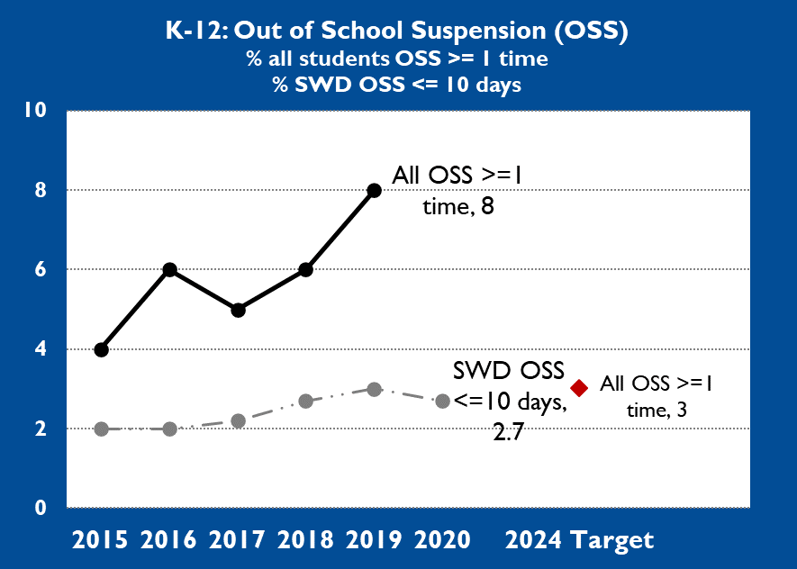
  2015-20 Performance Trends &
  2024 Targets
 | Gr. 9 cohort on track to graduate Year-end 2020-21, we will establish a baseline and set an improvement target for “% Gr. 9 cohort on track to graduate year-end)”
The Strategic Planning Team will consider adding additional strategic metrics in the future. For example: Discipline referral data Equitable access to rigorous courses and enrichment opportunities Climate survey data | The Strategic Planning Team will consider adding additional strategic metrics. For example: Discipline referral data Equitable access to rigorous courses and enrichment opportunities Climate survey data
6.9.2021

Slide 8
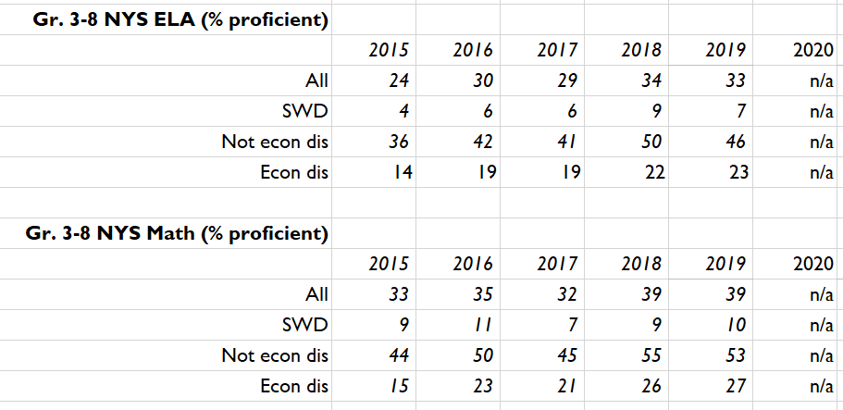
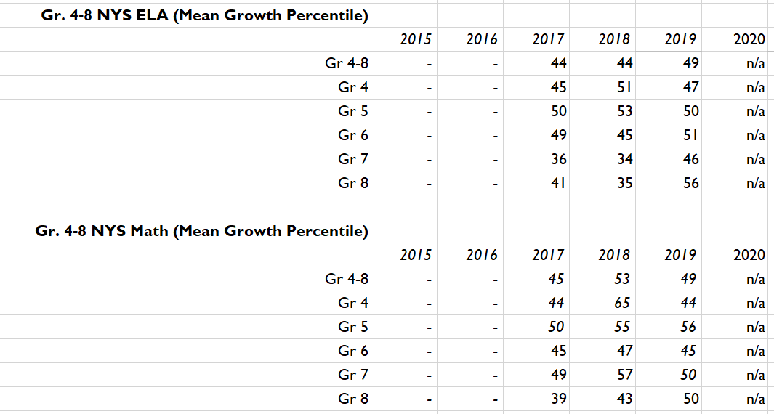
  2015-20 Performance Trends:
  NYS Gr. 3-8 Assessments
The United States Department of Education has required New York State to administer the Gr. 3-8 ELA & Math assessments in the 2020-21 school year. The results, however, will not be used to determine accountability status or for annual professional performance reviews (APPR). In the future, the district planning team will revisit whether to include Gr. 3-8 assessment results as a strategic performance metric. Below are trends for test refusal and proficiency rates, as well for as mean growth percentile. See appendix for definitions.
6.9.2021

Slide 9
  Appendix
Term or metric | Definition
Mission | Clearly communicates the primary aim or goal of an organization. Defines the organization’s single-most important reason for being. Answers the question: Why do we exist?
Vision | Indicates what the organization aspires to become. A vision is inspiring and may be unattainable. It compels the organization’s members and other stakeholders to extraordinary levels of commitment.
Core beliefs | A super set of beliefs that guide daily behavior and decision-making, large and small. They act as a touchstone to achieve the culture you aspire to have.
Cohort | A cohort is defined as the group of students who enroll in the district’s 9th grade in a given year and are present on BEDS day in October of that year. This year for example, we will form the 2021 cohort. After that, students are removed from the accountability cohort if, for example, they transfer to another district or pass away, and students are added to the cohort if they transfer in, even for just one day. The state then measures the performance of the cohort at five different intervals after four, five and six years on a variety of indicators, including graduation rate and dropout rate. For graduation outcome reporting, members of a cohort are in one of five buckets: (a) graduated with a Regents or local diploma, (b) received a non-diploma credential, (c) transferred to GED program, (d) are still enrolled or (e) dropped out.
% cohort graduating (4 yrs - 8/31) | The numerator is the count of students in the cohort who have graduated with a Regents or local diploma after four years of enrollment by August 31, and the denominator is the cohort count.
% cohort dropping out (5 yrs - 6/30) | The numerator is the count of students who have dropped out of school after five years of enrollment by June 30 and the numerator is the cohort count.
% graduating cohort achieving >=1 rigorous outcome | The state’s college, career and civic (CCCR) readiness index weights student’s graduation outcomes. Those outcomes weighted 1.5 and 2.0 in the index are considered rigorous. 1.5 weighted outcomes include: Regents diploma with a Career Development and Occupational Studies (CDOS) Credential; Regents diploma and earned high school credit for an AP or IB course; and Students with disabilities who earned a Skills & Achievement Credential and average of Level 3 on the NYS Alternative Assessment. 2.0 weighted outcomes include: Regents diploma with Advanced Designation; Regents diploma with Seal of Biliteracy; Regents and >= 3 an AP exam or >= 4 on an IB exam; Earned high school credit for a dual enrollment course (college level); Regents or local diploma with Technical Ed endorsement; Passed a nationally certified CTE exam; Regents diploma and P-Tech program; Regents diploma and Smart Scholars; Students with disabilities who earned a Skills & Achievement Credential (SAC) and average of Level 4 on the New York State Alternate Assessments (NYSAA). In the above calculation, the numerator is the count of students in the cohort who have graduated and earned a 1.5 or 2.0 weighted CCCR outcome and the denominator is the cohort count.
6.9.2021

Slide 10
  Appendix
Term or metric | Definition
Gr. 1-8 or 9-12 Chronic absence | A student is considered chronically absent if they are absent >= 10% of enrolled attendance days. Each student’s status is calculated based upon their individual date of enrollment. In the percentages above, the numerator is the count of students chronically absent and the denominator is the enrollment count. Chronically absent students are removed from the numerator under certain circumstances (e.g., they are receiving home instruction).
K-12: suspension rates | There are two metrics here: % students suspended out of school >= 1 time: The numerator is the count of K-12 students who have been suspended out of school >=1 time and the denominator is the total K-12 enrollment count % students with disabilities suspended out of school 10 days or less: The numerator is the count of K-12 students with disabilities who have been suspended out of school 10 days or less and the denominator is the total K-12 count of enrolled students with disabilities
NYS Gr. 3 - 8 ELA/Math (% proficient) | Students’ results on the state assessment are scored Level 1 (below proficient), Level 2 (partially proficient), Level 3 (proficient) and Level 4 (excelling). In the above calculation, the numerator is the count of students who have scores of “3” or “4” and the denominator is the count of students who sat for the assessment.
Gr. 4 - 8 ELA/Math Mean Growth Percentile | Students who have a valid state assessment score in a given year and also had a valid score in the previous year are assigned a growth score (1 – 99) called a student growth percentile (SGP). The district’s Mean Growth Percentile (MGP) is then the average of all students’ SGPs. The SGP is calculated by comparing a student’s growth year-to-year to all other “similar” students in the state (i.e., those students who had the same scaled score in the previous year). This is a very sophisticated statistical analysis. For our purposes in strategic planning, we simply need to understand how to interpret the scores: - An MGP score > 50 means the district is exceeding the average growth of similar students across NYS. - An MGP score < 50 means the district is lagging the average growth of similar students across NYS. - According to NYSED’s accountability rubric, an MGP of (a) <= 45 is Ineffective, (b) 45.1-50 is Developing, (c) 50.1-54 is Effective, (d) > 54 is Highly Effective.
SWD (Students with Disabilities) | Students who have and individual education plan (IEP). This does not include students with a 504.
Econ Dis (Economically Disadvantaged Students) | Economically disadvantaged students are those who participate in, or whose family participates in, economic assistance programs, such as the free or reduced-price lunch programs, Social Security Insurance (SSI), Food Stamps, Foster Care, Refugee Assistance (cash or medical assistance), Earned Income Tax Credit (EITC), Home Energy Assistance Program (HEAP), Safety Net Assistance (SNA), Bureau of Indian Affairs (BIA), or Family Assistance: Temporary Assistance for Needy Families (TANF). If one student in a family is identified as low income, all students from that household (economic unit) may be identified as low income.
Not Econ Dis | Students who are do not meet the criteria listed above for “economically disadvantaged” are considered “not economically disadvantaged.”
6.9.2021

Slide 11

Questions from the Board of Education…

Slide 12
Next steps:
  We will be launching plan to community at the beginning of this year
    Multi- media approach
    Opening day presentation
    Ongoing information will be shared community
    Community members will be invited to be apart of work that is being done
  Sub committees will meet three – four times next year
    Sub committees will consider goals, targets and plans
  We will align practices and resources to this plan
  We will monitor progress closely
  We will report outcomes as we move forward

