Slide 1

What is Title I?
Oswego City School District
2022-2023

Slide 2
What is Title I?
The Federal Government, through Every Student Succeeds Act (ESSA), provides school districts funds to support programs for students at-risk of not meeting state standards in reading, math, science and social studies. These funds are called Title I funds. Title I funds are the largest source of funding to K-12 schools.

Slide 3
How is funding calculated?
The New York State Education Department distributes Title I funds to districts. The amount of funding a district receives is determined by a complex formula that takes into account wealth ratios, census information and poverty numbers for a school district. The district’s allocation must be distributed to Title I schools in the district.
A school is designated a Title I school if its poverty percentage is above the district average.
The purpose of the funding is to ensure that all students have the chance to receive a high-quality education.

Slide 4
What are the Title I programs?
School districts can use their Title I funds for:
  AIS math, reading, social studies, and/or science programs
  Health related supports
  Before and after-school programs
  Supplemental supplies
  Parental involvement
Title I Districts must:
  Monitor students’ progress towards meeting state standards.
  Develop programs to support students’ progress towards meeting state standards.
  Give parents information on their child’s progress
  Involve parents in decision-making regarding Title I programs
  Hold an annual Title I meeting
  Annually review Title I programs and “policies”

Slide 5

How are students identified for Title I?
In grades K-6, STAR and state assessment data and teacher recommendations are used to identify students for Tier II interventions. If a student fails to respond to Tier II interventions, the SBIT (School Based Inquiry Team) would meet to review the students’ progress and consider additional interventions.

Slide 6

What does Title I reading and math look like?
Pull-out programs
Small group instruction
Focuses on students’ individual needs
On-going assessment
Programs are in addition to classroom reading and math instruction

Slide 7
Are there other programs for students at-risk?
Oswego City School District has many other programs to support students who may be at-risk of not meeting State standards. There are additional reading programs, math programs, ESL programs, Special Education programs, 504 services, etc. The only difference between these programs and Title I programs is that the Title I reading and math programs are funded by Federal Title I Funds, while the other programs are funded from a variety of other sources.

Slide 8
Parent’s Rights in Title I Programs
Parents must be given information about Title I in a timely manner and in a language that they understand
Parents have the right to request the professional qualifications of their child’s teacher
Districts must inform parents if their child is taught by a teacher that is not highly qualified for four or more consecutive weeks
Districts must inform parents of their child’s progress in reading and math, as well as their child’s results on State tests
Parents have the right to be involved in the development, review, and improvement of Title I programs
Parents are encouraged to attend parent involvement workshops
Parents are encouraged to ask questions about their children’s education

Slide 9
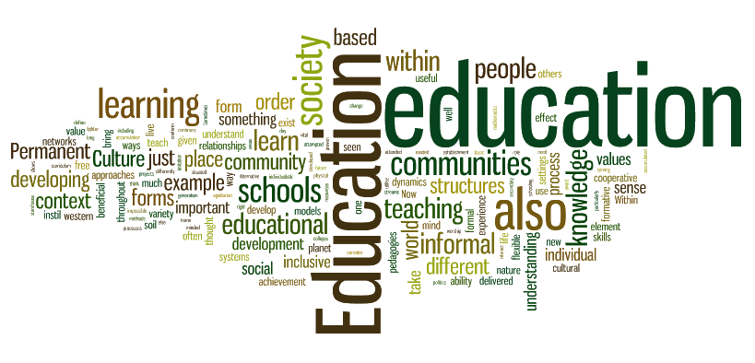
What is coming up in Title I?
Open House/Meet the Teacher Night (every September)
Review of Title I School/Parent Compact
Review the District’s Title I Policy #8260 and adopt this policy as the Building Level Parent Involvement Guidelines

